Slide 1
Team 02
Food Brand Understand Customer Trends

Slide 2
Our Team
Adithi KR
Poojitha CV
Priyanka Todavat
Vasuki Parthi
Under Guidance Of
Mentor Pavithra Kannan

Slide 3
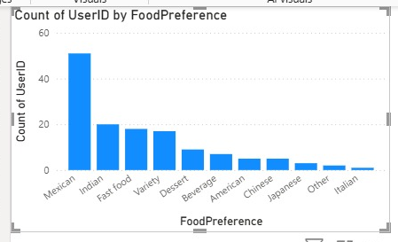
Recap of Milestone 1
Goal: Establish a unified, clean dataset for customer insights
Steps Done:
Data cleaning, deduplication, and standardization
Unified data model with relationships (UserID - PlaceID)
Calculated columns (e.g: Rounded Bill)
Early insights (e.g., cuisine trends → Mexican, Indian…)
Outcome: Strong foundation for advanced analytics

Slide 4
Objective of Milestone 2
Implement and verify sentiment analysis
Integrate sentiment categories (Positive, Neutral, Negative) into Power BI
Build visual dashboards for:
Sentiment trends over time
Sentiment by product, feature, and region
Keyword-based themes

Slide 5
Sentiment Analysis Process
Steps:
1. Extract customer feedback text
2. Apply AI/NLP sentiment classification
3. Map sentiment labels into dataset
4. Create DAX measures for ratios & trends
Example DAX: Positive % = DIVIDE([Positive Reviews],[Total Reviews],0)

Slide 6
Dashboard Highlights
Overall Sentiment Distribution (Pie/Bar chart – Positive/Neutral/Negative)
Sentiment by Region (Stacked bar → Bengaluru, Chennai, etc.)
Sentiment by Cuisine/Restaurant (Comparing Pizza, Indian, Mexican, etc.)

Slide 7
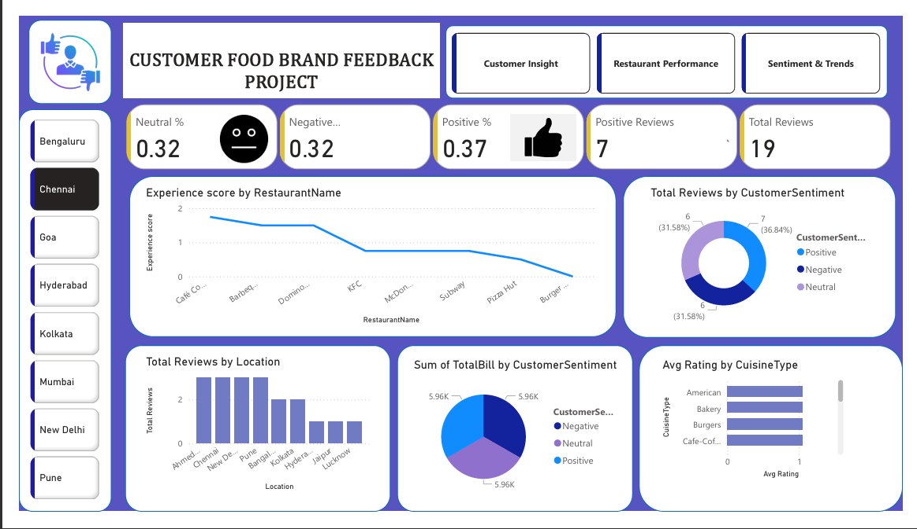

Slide 8
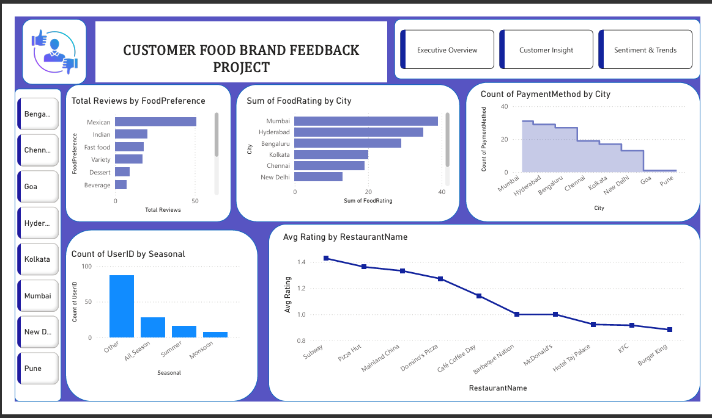

Slide 9
Insights Derived
Positive sentiment slightly higher than negative (e.g., ~37% vs ~32% )
Some cuisines (like Bakery & Burgers) attract more negative reviews
City-level analysis shows Mumbai & Bengaluru dominate reviews with varied sentiment
Actionable insight: Focus on improving cuisines/locations with higher negative feedback

Slide 10
Conclusion
Data → Insights journey moving from foundation (M1) to sentiment intelligence (M2)
Dashboard now empowers stakeholders to:
Track customer satisfaction trends
Identify problem areas (cuisine/location/restaurant)
Guide strategy for better customer experience

